Slide 7
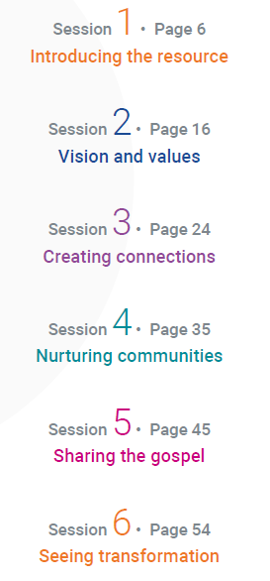
https://www.methodist.org.uk/ChurchAtTheMargins/
Go to: How to begin a Church at the Margins

Slide 11
Blank for title
Content

Slide 14
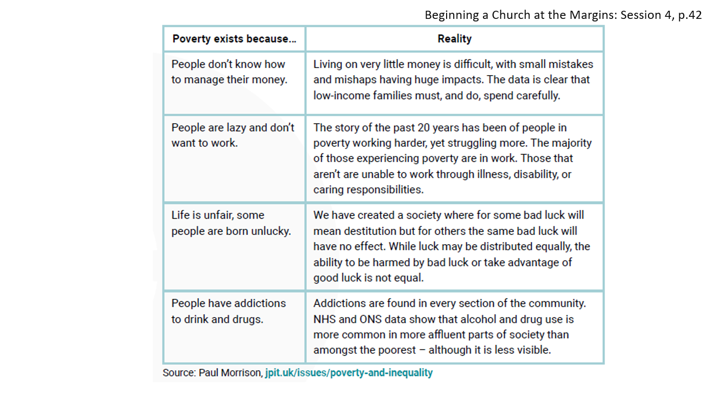

Slide 15
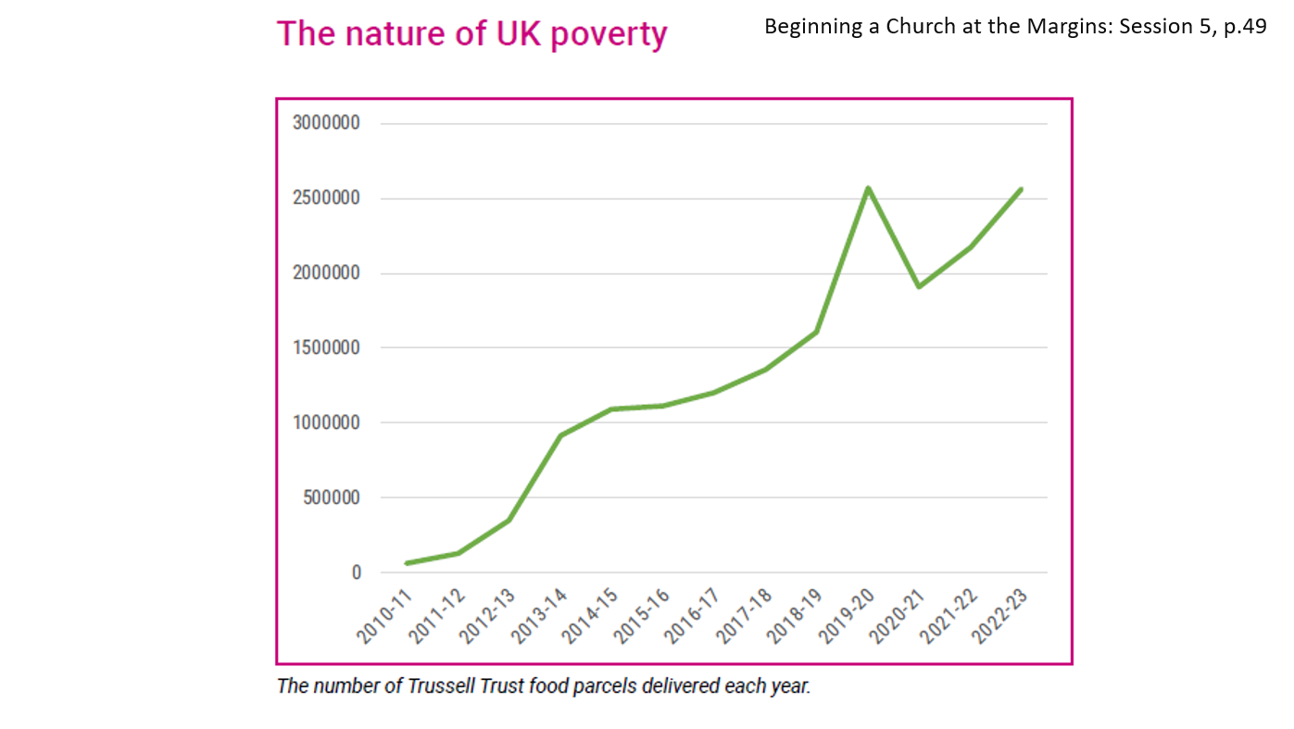

Slide 16
